Slide 1

Class methods
Lecturer
Rokas Slaboševičius
Data

Slide 2
Today you will learn
Class methods
Methods in the class
01
Private methods
02
Children's objects in class
03

Slide 3
Class methods
Class methods
Today we will learn about the methods you create in the classes you create.
In the last lesson, you learned how to create objects from the classes you described.
You also learn how to describe the properties of objects.
The next step in extending the functionality of a class is to create the necessary methods for it.

Slide 4
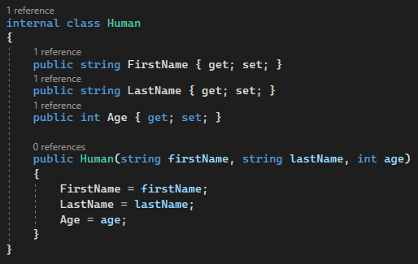
Class methods
Class methods
Let's create a simple class.

Slide 5
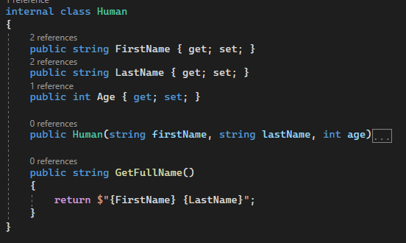
Class methods
Class methods
Let's create a method that returns the name of the human object with the last name.

Slide 6
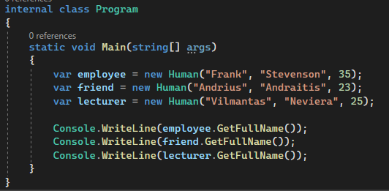
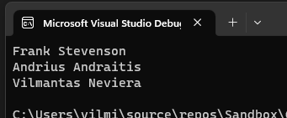
Class methods
Class methods
Let's create a few objects of the Human class and see how our method works.
As we can see, each object calls the GetFullName() method
used the self-assigned FirstName and LastName fields.

Slide 7
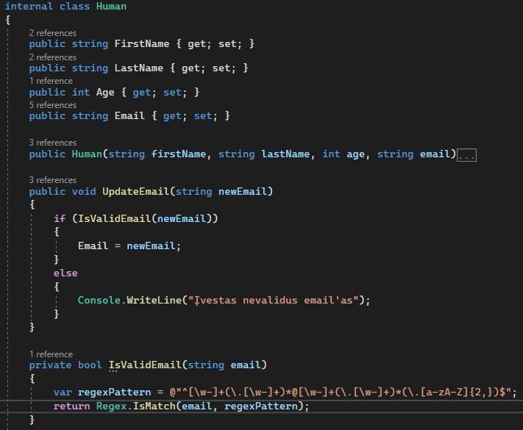
Private methods
Class methods
Sometimes methods are only needed for use within a class
and we don't want to invite them in from outside,
in that case, we assign the accessibility of the method to private.
In this example, the method is visible from the outside
UpdateEmail, but it calls the IsValidEmail method internally,
that we wouldn't see from the outside through the object we've created,
but it is still used when calling the UpdateEmail method.

Slide 8
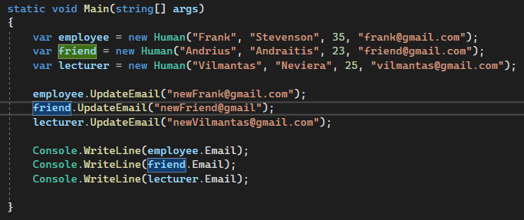

Private methods
Class methods
Let's see how it works

Slide 9
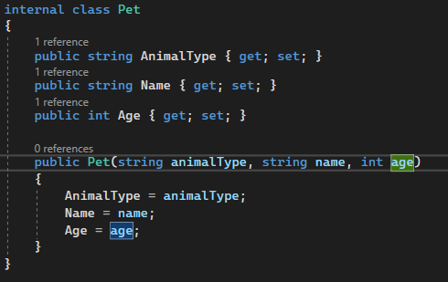
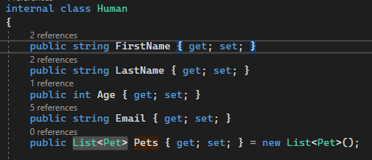
Manipulation of child objects
Class methods
We create a class called Pet, which we will use as a child class in the Human class

Slide 10
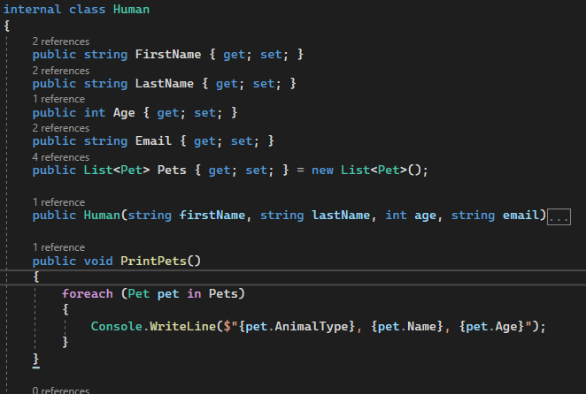
Manipulation of child objects
Class methods
We create a PrintPets method that will print
information about the animals assigned to the object created
from Human class.

Slide 11
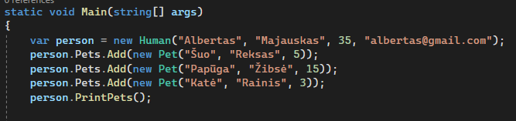

Manipulation of child objects
Class methods
Create an object from the Human class, add new objects created from the Pet class to the Pets list and call the PrintPets method from the Human object.

Slide 12
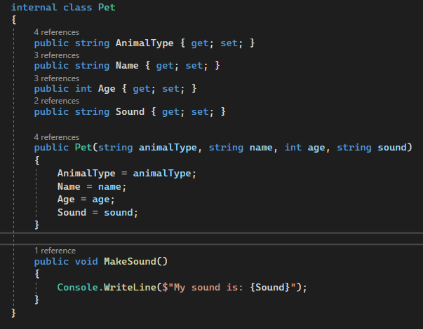
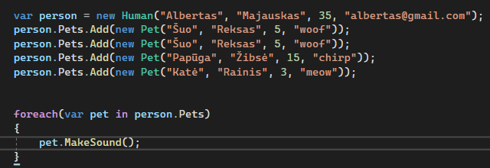

Manipulation of child objects
Class methods
We can also add a method to the child object and
call from the parent object

Slide 13
Methods overloading
Class methods
Sometimes there is a need to have more than one method with the same name but different parameters.
This is the purpose of method overloading.

Slide 14
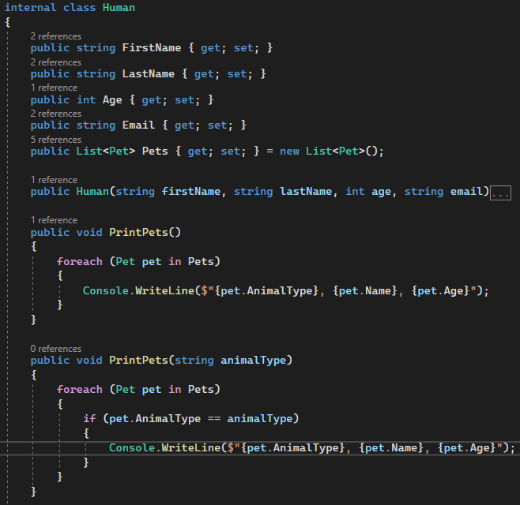
Methods overloading
Class methods
Here we see the overloaded PrintPets method, which
accepts the animalType parameter and prints animals
corresponding to this type.

Slide 15
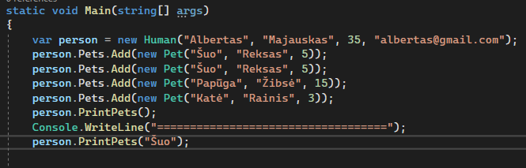
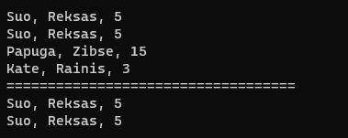
Methods overloading
Class methods
As you can see, we call the PrintPets method twice, once passing the parameter and once not. This means that
one version of the method is called the first time and another version the next time.

Slide 16

Class methods
Task 1
Create a class that stores a list of numbers. Add a method that allows you to add numbers to the list and another method that prints all the numbers in the list.
Create a class "Rectangle" with properties "Height" and "Width". Include methods that calculate area and perimeter.
Create a class "Circle" with the property "Radius". Include methods that calculate area and perimeter.
Create a class "Library" that stores a list of books(List<string>). Add methods to add and remove books.
Rewrite the implementation of the previous task, replacing the list of books with a list of book objects(List<Book>)

Slide 17
Class methods
Task 1
From here on, all lists (if they exist) must consist of objects of classes.
Create a class called "Playlist" to store your music tracks. Add methods to add and remove tracks.
Create a class "Movie" with properties "Title", "Genre" and "Rating". Add a method that returns whether the movie is watchable (if the rating is greater than 5).
Create a class "Book" with properties "Title", "Author" and "Pages". Add a method that returns how long it will take to read the book (assume 50 pages per hour).
Create a class "Computer" with the properties "Brand", "Model", "RAM" and "Storage". Add a method that returns whether the computer has enough memory to run a given program (the program needs the specified RAM size).

Slide 18
Lecture title
Headline
www.youtube.com
Useful information

